Slide 1
BIKE SHARE ANALYSIS

Slide 2
REPORT BY: ODION TAIYE OJEABURU
I AM A DATA ANALYST GIVEN THE TASK OF PERFORMING ANALYSIS OF THE BIKE SHARE COMPANY DATA.
HAVING STUDIED THE DATA GIVEN TO ME, I AM CONFIDENT THAT THE INSIGHTS I HAVE PROVIDED WILL AID THE MANAGEMENT IN TAKING POSITIVE STEPS IN ACHIEVING IT’S GOALS AND HELP IN DECISION MAKING.

Slide 3
INTRODUCTION
THE COMPANY IS A BIKE SHARE COMPANY THAT OFFERS SERVICES IN BIKE RIDES ACROSS THE COUNTRY FROM ONE STATION TO ANOTHER. THESE BIKES ARE PICKED UP FROM DESIGNATED LOCATIONS OF THE COMPANY AND LATER RETURNED TO DESIGNATED LOCATIONS PROVIDED BY THE COMPANY ACROSS GEOGRAPHICAL REGIONS WITHIN A STIPULATED TIME.
THERE ARE TWO TYPES OF CUSTOMERS THAT EXISTS, WHICH ARE SUBSCRIBERS WHO ARE FULLY REGISTERED WITH THE COMPANY AND NON-SUBSCRIBERS WHO ONLY MAKE USE OF THE SERVICE ON A ONE OFF OCCATION.
THIS ANALYSIS WILL HELP IDENTIFY SIGNIFICANT TRENDS IN THE COMPANY.

Slide 4
DATA
THE DATA WAS GOTTEN FROM THE COMPANY’S DATA BASE WHICH WAS STORED AS A CSV FILE AND LATER CONVERTED TO XLSX FILE.
THIS DATA IS A PRIMARY DATA COLLECTED BY THE COMPANY AND THEREFORE HIGLY RELIABLE FOR THIS PURPOSE.

Slide 5
DATA PROCESSING
THE CSV FILE WHICH THE DATA WAS STORED IN WAS CONVERTED TO XLSX FORMAT.
MICROSOFT EXCEL WAS USED FOR DATA PREPARATION, EXPLORATION AND ALSO VISUALIZATION.
THE DATA WAS ALSO CLEANED AND PREPARED FOR ANALYSIS.

Slide 6
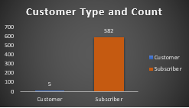
RESULT: CUSTOMER TYPE AND COUNT
CUSTOMER TYPE: (I) SUBSCRIBER
(II) CUSTOMER(NON-SUBSCRIBER)
TOTAL NUMBER OF CUSTOMERS: 587
THE CHART BELOW SHOWS A TOTAL NUMBER OF 582 FULL SUBSCRIBERS AND 5 NON-SUBSCIRBERS.

Slide 7
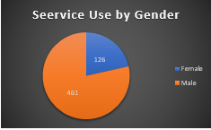
COUNT OF BIKE USAGE BY GENDER
NUMBER OF MALE USERS: 461
NUMBER OF FEMALE USERS:126
FROM THE CHART BELOW, MEN MAKE USE OF THE SERVICE MORE THAN THE WOMEN.

Slide 8
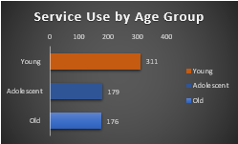
HIGHEST SERVICE USERS BY AGE GROUP
AGE GROUP TYPES: (I) ADOLESCENT (II) YOUNG (I) OLD
THE CHART BELOW SHOWS THAT YOUNG PEOPLE MAKE USE OF THE SERVICE MOST WITH A TOTAL NUMBER OF 311 USERS.

Slide 9
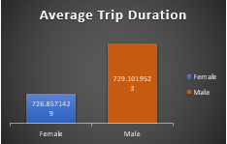
AVERAGE TRIP DURATION
THE MALES HAVE THE HIGHEST TRIP DURATION ACCORDING TO THE CHART BELOW.

Slide 10
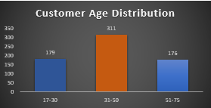
AGE DISTRIBUTION OF CUSTOMERS
THE AGE DISTRIBUTION OF THE CUSTOMERS FROM THE CHART BELOW ARE: 17-30YRS, 31-50YRS AND 51-75YRS RESPECTIVELY.
CUSTOMERS BETWEEN THE AGE RANGE OF 31-50 HAS THE HIGHEST USE OF THE SERVICE.

Slide 11
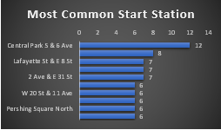
MOST COMMON START STATION
THE MOST COMMON START STATION FORM THE CHART BELOW IS CENTRAL PARK 5 AND G AVENUE.

Slide 12
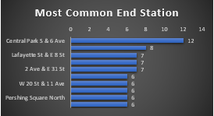
MOST COMMON END STATION
THE MOST COMMON END STATION FORM THE CHART BELOW IS CENTRAL PARK 5 AND G AVENUE.

Slide 13
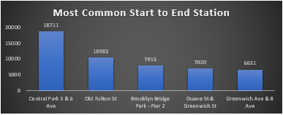
MOST COMMON TRIP START TO END STATION
THE MOST COMMON TRIP START TO END STATION FORM THE CHART BELOW IS CENTRAL PARK 5 AND G AVENUE.

Slide 14
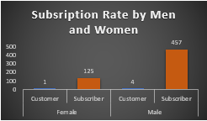
SUBSRIPTION RATE AMONG MEN AND WOMEN
THE SUBSCRIPTION RATE AMONG MEN AND WOMEN FROM THE CHART BELOW SHOWS:
MALE SUBSCRIBERS TO BE 457 AND NON SUBSCRIBERS TO BE 4
FEMALE SUBSCRIBERS TO BE 125 AND NON SUBSRIBERS TO BE 1

Slide 15
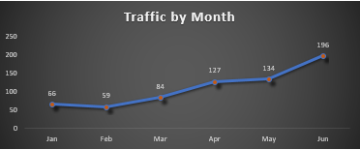
HIGHEST TRAFFIC BY MONTH
THE CHART BELOW SHOWS THAT THE MONTH OF JUNE HAS THE HIGHEST INFLOW OF BIKE USERS WITH A TOTAL OF 196 USERS.

Slide 16
RECOMMENDATIONS
THE NUMBER OF MALE USERS COMPARED TO THE FEMALE USERS IS WIDE, AS SUCH MORE PUBLICITY SHOULD BE MADE TARGETING MORE FEMALES, SHOWING THEM THE BENEFITS OF USING THE SERVICE, WHILE ASLO KEEPING A CLOSE CHECK ON THE MALES TO MAINTAIN MOMENTUM.
NON SUBSCRIBERS SHOULD ALSO BE A POINT OF TARGET DURING PUBLICITY WITH INCENTIVES PROPOSED FOR THEM TO FULLY SUBSCRIBE AND BENEFITS ALSO MADE KNOWN TO THEM AS WELL.
SINCE THE YOUNG PEOPLE ARE THE MOST AND HIGHEST USERS OF THE SERVICE, MORE AWARENESS SHOULD BE FOCUSED ON THEM AND ALSO MORE LIKE AN EVENT THAT WILL ATTRACT MORE YOUNG PEOPLE TO THE SERVICE.

Slide 17
RECOMMENDATIONS CONTD.
MORE BIKES SHOULD BE STATIONED AT CENTRAL PARK 5 AND G AVENUE SINCE IT HAS THE HIHEST START AND END STATION, AS WELL AS START TO END STATION RESPECTIVELY.
THE MONTH OF JUNE HAS THE HIGHEST TRAFFIC OF USERS. THIS MONTH SHOULD BE THE MAIN FOCUS OF ATTENSION AND INTEREST WITH MORE TEAM MEMBERS DESIGNATED TO CATER FOR THE CROWD IN THAT PARTICULAR MONTH.

